Slide 1
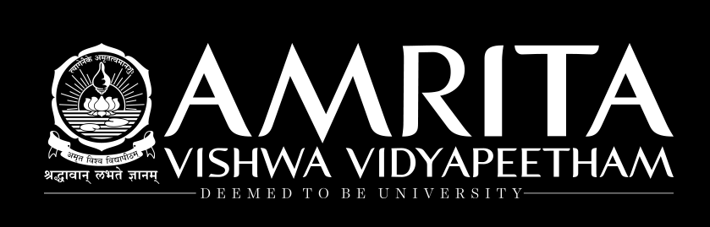
Feed forward Neural Network
Hyperparameter Tuning

Slide 2
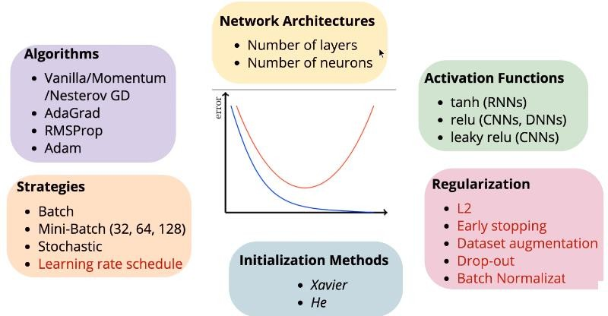
Feed Forward NN - Hyper Parameter Tunings

Slide 3
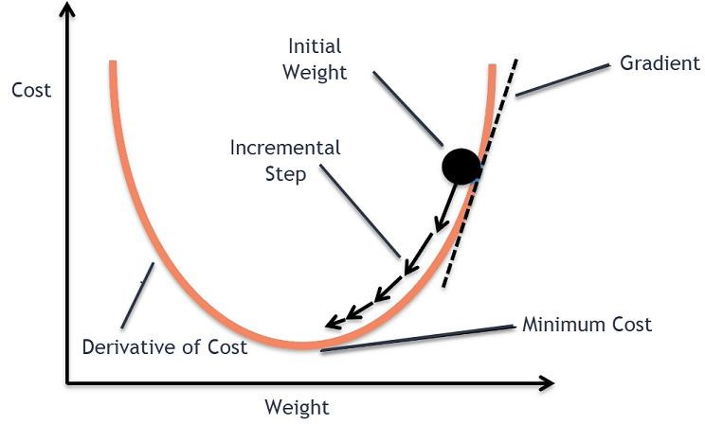
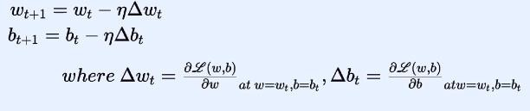
Recap-Gradient Descent
Gradient descent is a way to minimize an objective function parameterized by a model's parameters by updating the parameters in the opposite direction of the gradient of the objective function
The learning rate η determines the size of the steps we take to reach a (local) minimum. In other words, we follow the direction of the slope of the surface created by the objective function downhill until we reach a valley
Steps
Compute the slope (gradient) that is the first-order derivative of the function at the current point
Move-in the opposite direction of the slope increase from the
current point by the computed amount

Slide 4
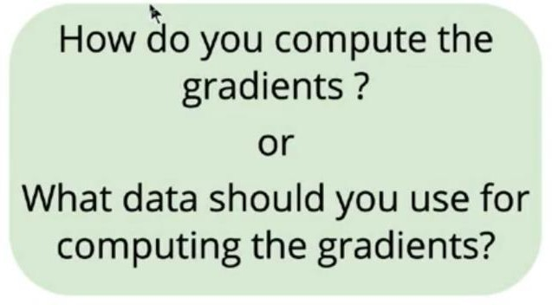
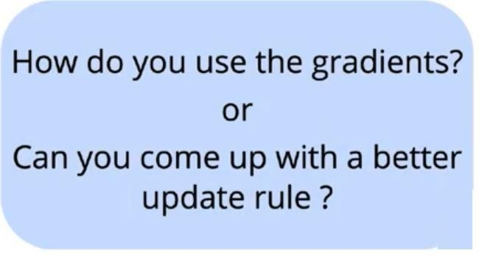
Gradient Descent Algorithm- Tuning
Gradient Descent Variants
Batch gradient descent
Stochastic gradient descent
Mini-batch gradient descent
Gradient descent optimization algorithms
Momentum
Nesterov accelerated gradient
Adagrad
Adadelta
RMSprop
Adam
AdaMax
Nadam
AMSGrad
Depending on the amount of data, we make a trade-off between the accuracy of the parameter update and the time it takes to perform an update.

Slide 5
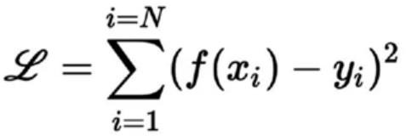
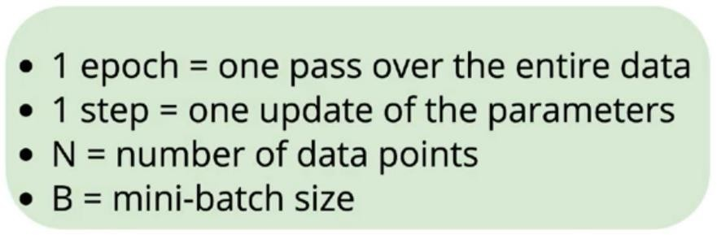
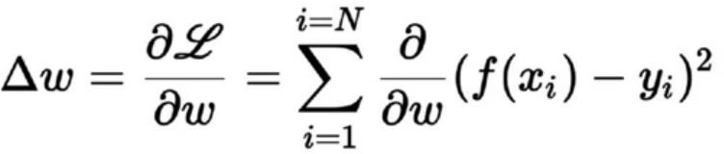
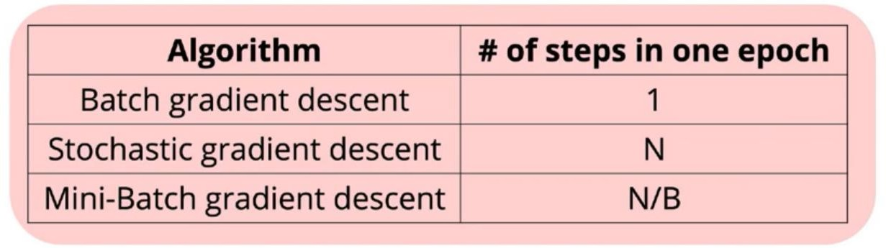
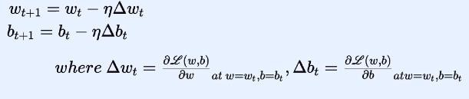
Variants of Gradient Descent
What is one epoch? One step?

Slide 6
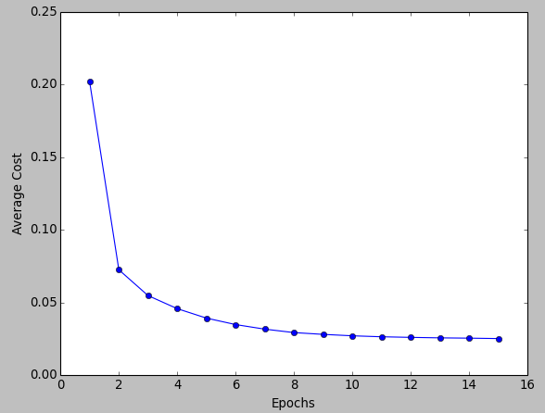
1 step in 1 epoch
Batch Gradient Descent
Batch gradient descent
In Batch Gradient Descent,
All the training data is taken into consideration to take
a single step.
We take the average of the gradients of all the training examples and then use that mean gradient to update our parameters.
So that’s just one step of gradient descent in one
epoch.
Batch Gradient Descent is great for convex or relatively smooth error manifolds. In this case, we move somewhat directly towards an optimum solution.
But what if our dataset is very huge. Suppose our dataset has 5 million examples, then just to take one step the model will have to calculate the gradients of all the 5 million examples.??

Slide 7
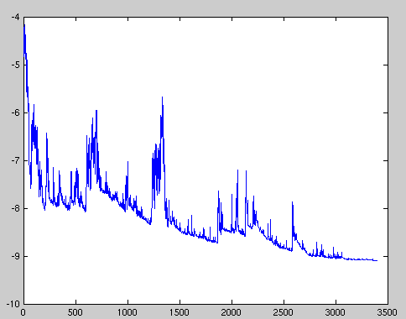
Stochastic Gradient Descent
N steps in 1 epoch
In Batch Gradient Descent we were considering all the examples for every step of Gradient Descent. But what if our dataset is very huge. Deep learning models crave for data. The more the data the more chances of a model to be good
Suppose our dataset has 5 million examples, then just to take one step the model will have to calculate the gradients of all the 5 million examples
In Stochastic Gradient Descent (SGD), we consider just one example at a time to take a single step.
Observations
Since we are considering just one example at a time the cost will fluctuate over the training examples and it will not necessarily decrease.
But in the long run, you will see the cost decreasing with fluctuations.
Because the cost is so fluctuating, it will never reach the minima but it will keep dancing around it.
SGD can be used for larger datasets. It converges faster when the dataset is large as it causes updates to the parameters more frequently
cost
epoch

Slide 8
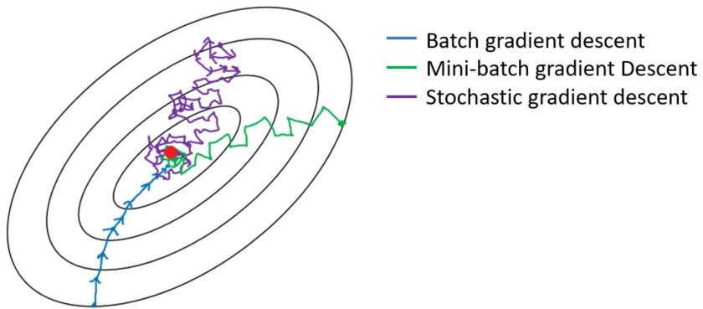
Mini Batch Gradient Descent
N/B steps in 1 epoch
Batch Gradient Descent can be used for smoother curves.
SGD can be used when the dataset is large.
Batch Gradient Descent converges directly to minima. SGD converges faster for larger datasets.
But, since in SGD we use only one example at a time, we cannot implement the vectorized implementation on it. This can slow down the computations. To tackle this problem, a mixture of Batch Gradient Descent and SGD is used- Mini Batch GD.
Mini Batch gradient Descent
We use a batch of a fixed number of training examples which is less than the actual dataset and call it a mini-batch. Doing this helps us achieve the advantages of both Batch and stochastic GD. So, after creating the mini-batches of fixed size, iterate over mini-batches of size B:
N/B step in one epoch ( N : total no of data points, B batch size)
Normal Batch size- 32,64,128

Slide 9
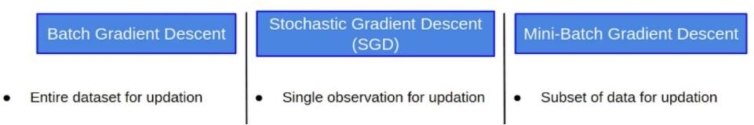
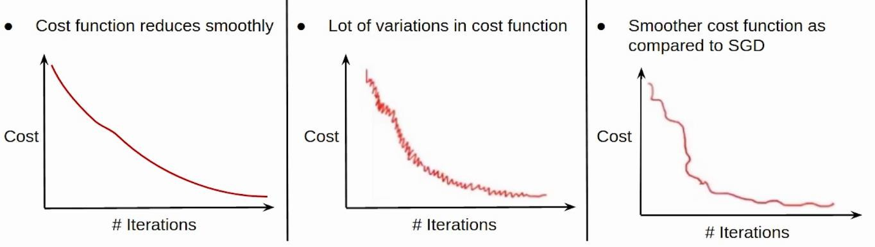

Slide 10
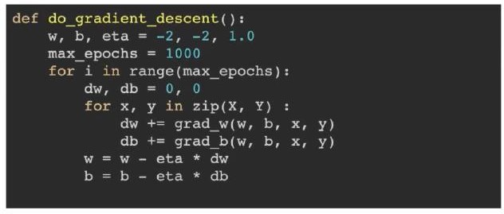
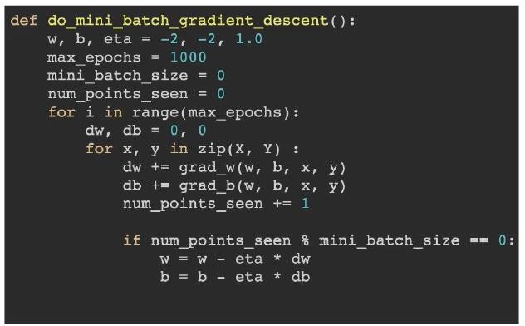
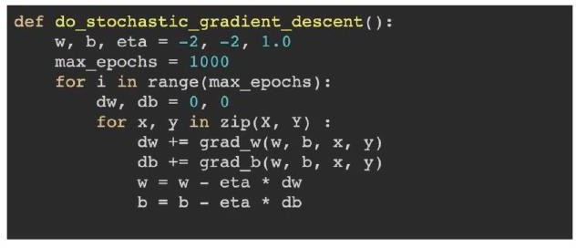
Batch gradient descent
Mini-batch gradient descent
Stochastic gradient descent

Slide 11
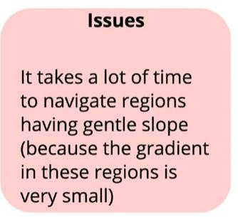
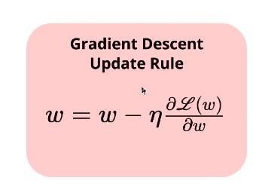
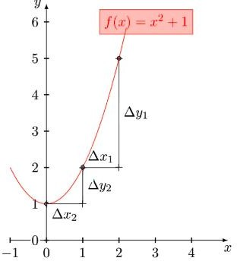
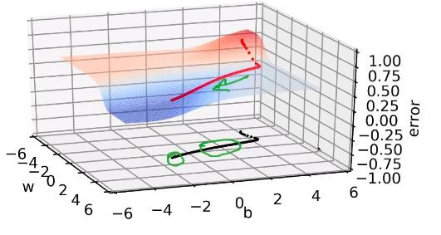
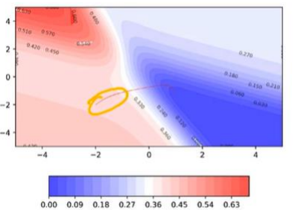
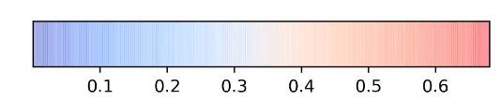
Issue with Gradient Descent optimisation
vanilla gradient descent
2D contour Maps-3D surface on 2D map

Slide 12
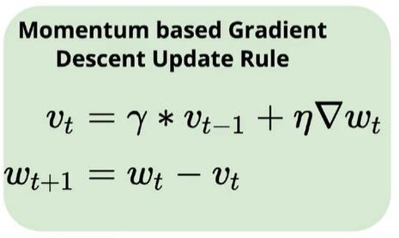
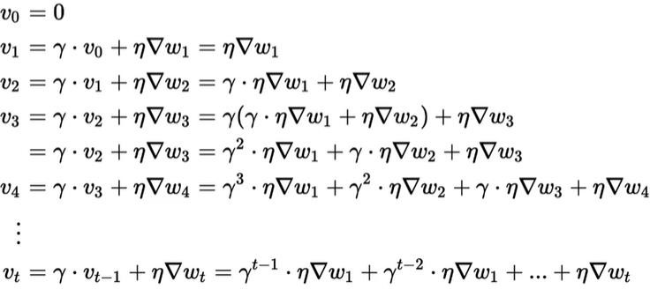
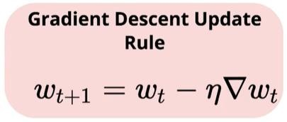
Gradient Descent Optimisation
Momentum-Based Gradient Descent
In addition to the current update, we also look at the history of updates.
You can see that the current update is proportional to not just the present gradient but also gradients of previous steps, although their contribution reduces every time step by γ(gamma) times. And that is how we boost the magnitude of the update at gentle regions.
Intuition :If I am repeatedly being asked to move in the same direction, then I should probably gain some confidence and start taking bigger steps in that direction. Just as a ball gains momentum while rolling down a slope.

Slide 13
Momentum (magenta) vs. Gradient Descent (cyan) on a surface with a global minimum (the left well) and local minimum (the right well)
Momentum-Based Gradient Descent. 100 iterations of vanilla gradient descent make the black patch.

Slide 14
Advantage and disadvantage of momentum based GD
momentum would cause us to overshoot and run past our goal!
We can observe that momentum-based gradient descent oscillates in and out of the minima valley as the momentum carries it out of the valley. This makes us take a lot of U-turns before finally converging. Despite these U-turns, it still converges faster than vanilla gradient descent
It is evident that even in the regions having gentle slopes, momentum-based gradient descent can take substantial steps because the momentum carries it along.
Can we do something to reduce the oscillations/U-turns? Yes, Nesterov Accelerated Gradient Descent helps us do just that.

Slide 15
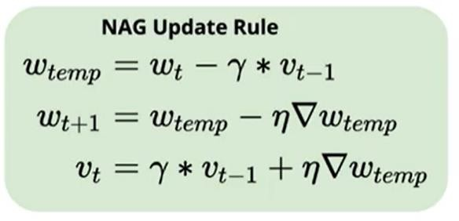
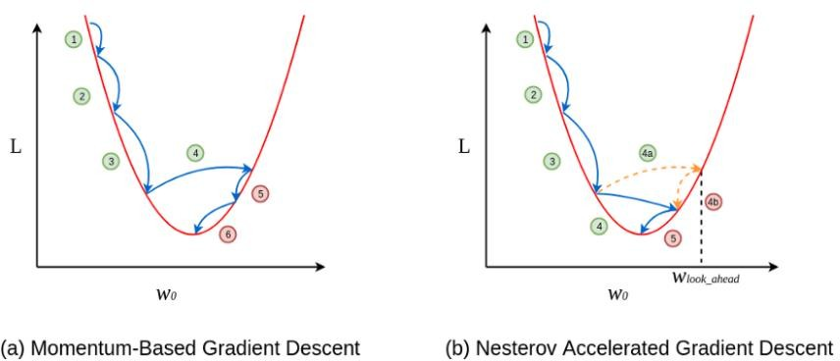
Nesterov Accelerated Gradient Descent (NAG)
Intuition : Look ahead before you leap!
Effectively look ahead by calculating the gradient not w.r.t. to our current
parameters θ but w.r.t. the approximate future position of our parameters:
Calculate the gradient at the partially updated value w_{temp} instead of calculating using the current value w_{t}
NAG’s case, every update happens in two steps — first, a partial update, where we get to the look_ahead point and then the final update which is negative
This negative final update slightly reduces the overall magnitude of the update, still resulting in an overshoot but a smaller one when compared to the vanilla momentum-based gradient descent

Slide 16
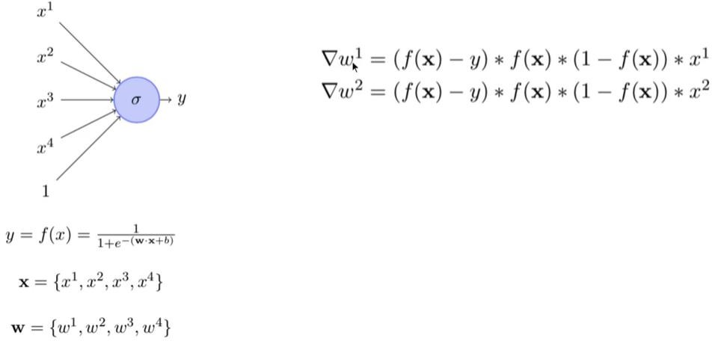


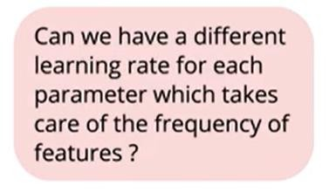
Why adaptive learning rate needed ?
∞
∞
Updated
In real data some features will be sparse and some dense.
We want Ƞ to be aggressive in case of sparse features and less aggressive in case of dense features- adaptive learning rate ( I don’t mind learning slow when feature is ON all the time. But when feature is ON less frequently then learn aggressively when it is ON)

Slide 17
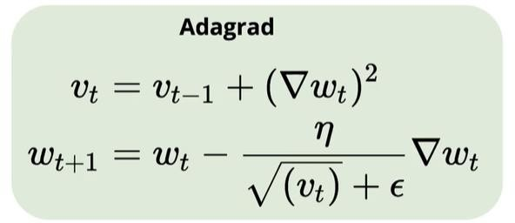
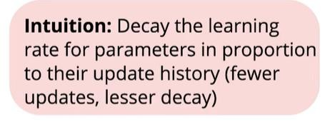
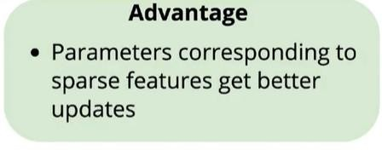
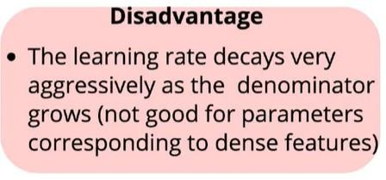
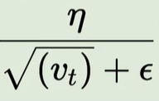
Adagrad
Performing smaller updates (i.e. low learning rates) for parameters associated with frequently occurring features, and larger updates (i.e. high learning rates) for parameters associated with infrequent features. For this reason, it is well-suited for dealing with sparse data
Denominator will be less for sparse features (History taken) and will be high for dense features. Hence high fraction for sparse features – learn aggressive. Low fraction for dense features- learn less aggressive

Slide 18
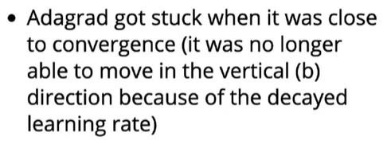
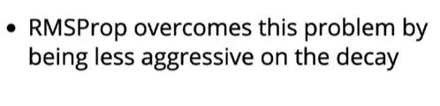
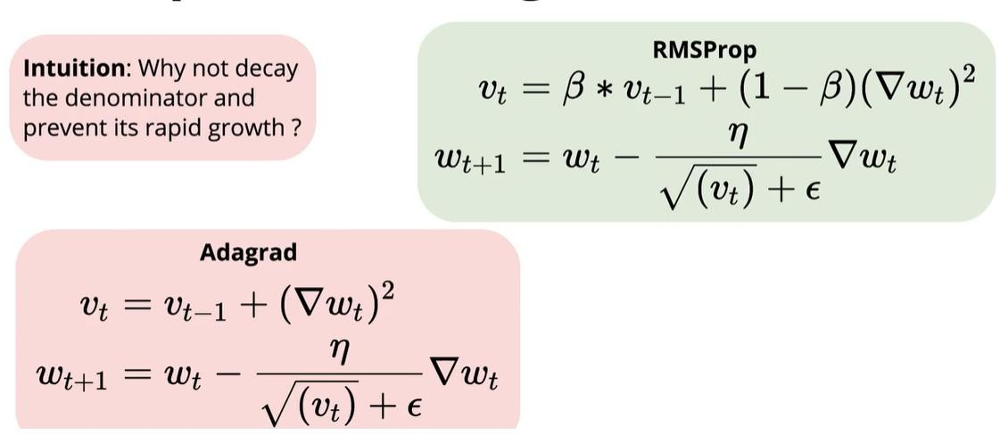
RMSProp
RMSprop resolve Adagrad's radically diminishing learning rates.
It divides the learning rate by an exponentially decaying average of squared gradients

Slide 19
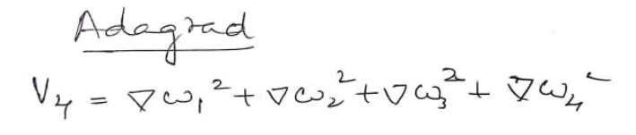
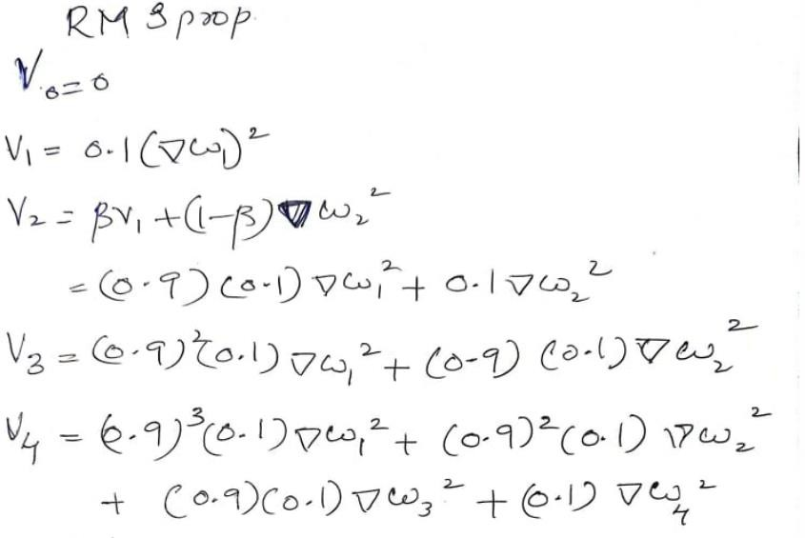
RMSProp Will prevent blowup of denominator for dense features

Slide 20
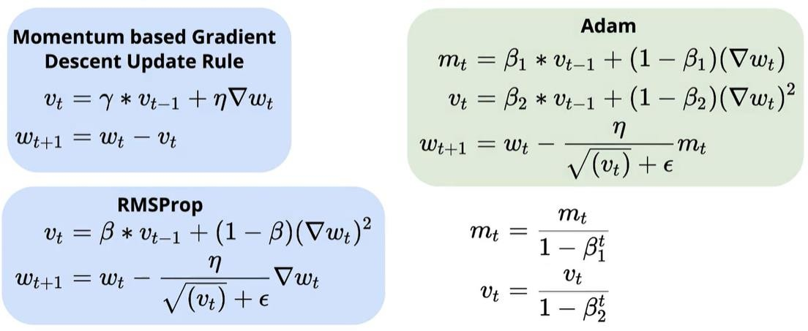
In addition to storing an exponentially decaying average of past squared gradients vt like Adadelta and RMSprop, Adam also keeps an exponentially decaying average of past gradients mt, similar to momentum.
Adam
First Moment (EMA of Gradients)
Second Moment (EMA of Squared Gradients)
Combines the advantage of momentum and RMSprop
At the start, the EMA is biased toward zero. To fix this, Adam applies

Slide 21
Comparison- Visualisation
GD optimization on loss surface contours
GD optimization on saddle point
Notes:
A saddle point is a point in a function where the gradient is zero, but it is neither a local minimum nor a local maximum. Instead, it acts like a high point in one direction and a low point in another.

Slide 22
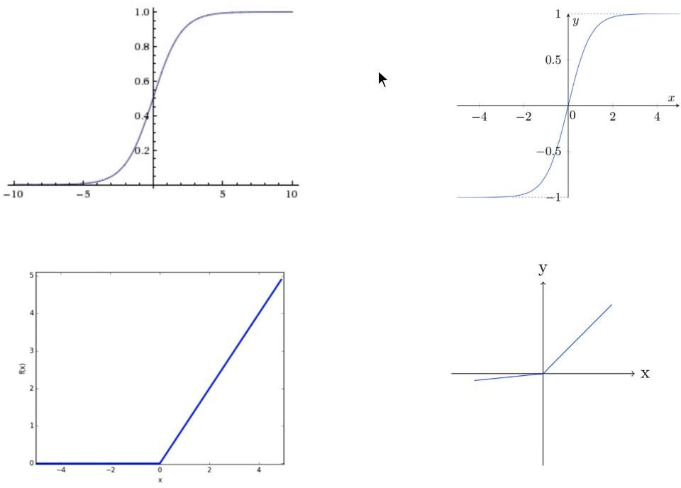
Activation functions
Logistic/Sigmoid
tanh
ReLU
Leaky ReLU

Slide 23

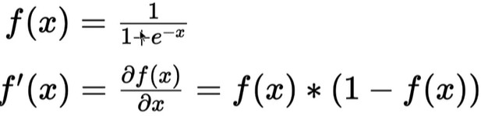
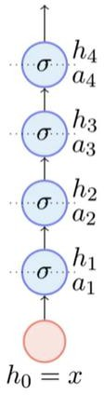
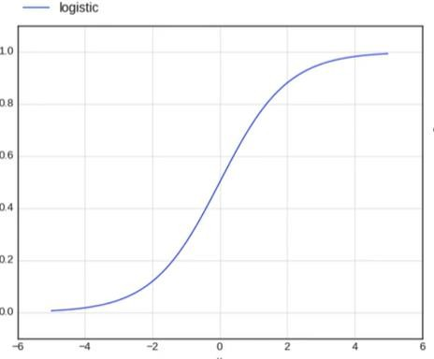
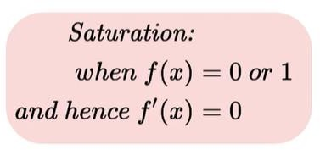
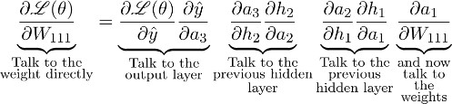


Logistic/Sigmoid
Vanishing Gradient problem
=0 Then
= 0 and hence no updation in weight happens
Gradient at some neurons vanishes and no more learning happens- Vanishing gradient

Slide 24
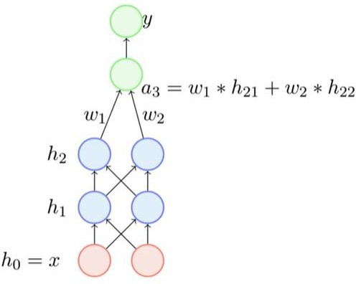








Logistic/Sigmoid
+/-
+
Will be either all + or all-
+/-
+
Logistic Neuron is not zero centered which restricts the movement of gradient on training – takes time to converge

Slide 25




Better Activation Functions- tanh

Slide 26



Better Activation Functions- ReLU (Rectified Linear activation Unit )

Slide 27




Issues with ReLU

Slide 28



Leaky ReLU

Slide 29


Overfitting - Underfitting
In supervised learning, underfitting happens when a model unable to capture the underlying pattern of the data ( Not able to learn)
overfitting happens when our model captures the noise along with the underlying pattern in data.

Slide 30



Bias- Variance
Notes:
Bias – "Error due to overly simple assumptions"
Variance – "Error due to sensitivity to small fluctuations"
Bias and Variance: A Simple Real-World Analogy (Cooking 🍳)
Imagine you're trying to cook a dish following a recipe. Your goal is to make the perfect dish, just like a professional chef.
1. High Bias (Underfitting) – The Inexperienced Cook 👩‍🍳
You follow a very basic version of the recipe without adjusting for taste.
You ignore important details like seasoning and cooking time.
The food always turns out bland and undercooked—consistently bad.
🔹 Real-world example: A simple model (like linear regression) that doesn’t learn complex patterns and always makes similar mistakes.
2. High Variance (Overfitting) – The Overthinker Cook 👨‍🍳
You change the recipe too much based on every small feedback.
One day, you add too much salt, another day too little spice, and the results vary wildly.
Your dish is sometimes perfect but often terrible because you memorize small details instead of learning general principles.
🔹 Real-world example: A deep learning model that memorizes training data but fails on new test data.
3. Low Bias, Low Variance (Good Cooking) – The Skilled Chef 👩‍🍳👨‍🍳
You understand the recipe well but also adjust it wisely based on experience.
Your dishes consistently turn out delicious because you balance creativity with structure.
You’ve learned the general rules of cooking rather than just memorizing the steps.
🔹 Real-world example: A well-trained machine learning model that generalizes well to new data.

Slide 31

Bias and Variance trade-off
What happens if you train with different subsets of training data
Top Row (High Bias - Underfitting)
sine curve(Black color) is the actual model
Bottom Row (High Variance - Overfitting)
Notes:
Top Row (High Bias - Underfitting)
The top row shows models that are too simple (low-degree polynomial or linear models).
First plot (Left): The model is a straight line (linear regression). It fails to capture the sinusoidal trend and always predicts a nearly constant slope.
Second plot (Middle): Another linear fit with slight variation in slope, but still unable to capture the actual function.
Third plot (Right): Different linear fits trained on different subsets of data result in slight variations, but they all remain close to a straight line.
🔹 Key Observation: These models have high bias because they are too simple and unable to capture the complexity of the data. They consistently make similar errors, leading to underfitting.
Bottom Row (High Variance - Overfitting)
The bottom row shows more complex models (higher-degree polynomials).
First plot (Left): The model fits the sine wave but also captures extra fluctuations, indicating some level of overfitting.
Second plot (Middle): As the polynomial degree increases, the model begins to fit noise in the data, resulting in high variance.
Third plot (Right): Different complex models trained on different subsets of data result in wildly different predictions, showing how high-variance models are sensitive to small changes in the training set.
🔹 Key Observation: These models have high variance because they are overly flexible and adapt too much to the training data, capturing noise instead of general patterns. This leads to overfitting, where the model performs well on training data but poorly on new, unseen data.

Slide 32




Bias and Variance trade-off
Variance is the variability of model prediction for a given data point or a value which tells us spread of our data. Model with high variance pays a lot of attention to training data and does not generalize on the data which it hasn’t seen before. As a result, such models perform very well on training data but has high error rates on test data.
Bias is the difference between the average prediction of our model and the correct value which we are trying to predict. Model with high bias pays very little attention to the training data and oversimplifies the model. It always leads to high error on training and test data.
f^​(x) is the model’s predicted function.
f(x) is the true function (ground truth).
E[f^(x)] is the expected prediction over multiple training sets.
Notes:
Variance measures how much the model’s predictions fluctuate when trained on different datasets.
The variance formula calculates the expected squared deviation of predictions from their mean.

Slide 33



Bias and Variance trade-off
Under-fitting
Over-fitting
Notes:
Left Side: Model Behavior
Top Plot (High Bias / Underfitting)
The black curve represents the true function (ground truth).
The blue line represents a simple model (low complexity) that fails to capture the true function.
The model has a high test error because it fails to learn the patterns in the data.
This is an example of underfitting, where the model is too simple and has high bias.
Bottom Plot (High Variance / Overfitting)
The model (blue curve) fits the training data too well, capturing even the noise.
The test error is still high, but now due to high variance—the model performs well on training data but generalizes poorly.
This is an example of overfitting, where the model is too complex.
Right Side: The Bias-Variance Tradeoff Graph
The x-axis represents model complexity (simpler → more complex).
The y-axis represents error (lower is better).
The blue curve represents training error, which decreases as model complexity increases.
The red curve represents test error, which decreases initially but rises if the model becomes too complex.

Slide 34

Overfitting Underfitting
In supervised learning, underfitting happens when a model unable to capture the underlying pattern of the data. These models usually have high bias and low variance. It happens when we have very less amount of data to build an accurate model or when we try to build a linear model with a nonlinear data
In supervised learning, overfitting happens when our model captures the noise along with the underlying pattern in data. It happens when we train our model a lot over noisy dataset. These models have low bias and high variance. These models are very complex like Decision trees which are prone to overfitting.
Notes:
Top-Left: High Bias, Low Variance (Underfitting)
Predictions are clustered together, but they are far from the true value.
The model is too simple and consistently wrong → systematic error.
Top-Right: High Bias, High Variance
Predictions are spread out and far from the target.
The model is neither learning correctly nor consistently.
Bottom-Left: Low Bias, Low Variance (Ideal Model)
Predictions are clustered close to the true value (center of the target).
The model is both accurate and consistent.
Bottom-Right: Low Bias, High Variance (Overfitting)
Predictions are scattered but close to the true value on average.
The model learns too much, including noise, leading to instability.

Slide 35


Bias and Variance trade-off
How to deal with it practically in DLL ?
Under-fitting
Over-fitting

Slide 36

Data Augmentation
Notes:
Insights from the Text
Low Data, Low Complexity
When training data is small, a highly complex model can memorize the data, driving the training error to zero (overfitting).
Impact of Data Augmentation
Increasing data size (via augmentation) makes it harder for the model to memorize training data, preventing overfitting.
Training error may not reach zero, but test error improves (better generalization).
Overlapping with Test Data
Excessive data augmentation might introduce samples too similar to test data.
This could artificially lower test error but reduce the true evaluation quality.

Slide 37
Data Augmentation
Data augmentation techniques generate different versions of a real dataset artificially to increase its size. Computer vision and natural language processing (NLP) models use data augmentation strategy to handle with data scarcity and insufficient data diversity.
Data augmentation algorithms can increase accuracy of machine learning models.
According to an experiment, a deep learning model after image augmentation performs better in training loss (i.e. penalty for a bad prediction) & accuracy and validation loss & accuracy than a deep learning model without augmentation for image classification task.

Slide 38




Data Augmentation
Adding noise
A section of the image is selected, cropped and then resized to the original image size
The image is flipped horizontally and vertically
Translation

Slide 39


Data Augmentation
Contrast changed
Scaling

Slide 40


Regularization- Intuition behind L2 regularization
sgd = torch.optim.SGD(model.parameters(), weight_decay=weight_decay)
pytorch optimizers have a parameter called weight_decay which corresponds to the L2 regularization factor:

Slide 41



Slide 42

Regularization- Early Stopping
After certain no of epoch if validation error is increasing through training error decreasing, it means model is getting over fitted. So we need to stop the training
Stopping Criteria: Training is stopped as soon as the performance on the validation dataset decreases as compared to the performance on the validation dataset at the prior training epoch (e.g. an increase in loss).

Slide 43
Batch Normalisation Drop out

Slide 44

Normalizing the input features

Slide 45



Normalisation of hidden layers
Why Batch normalization?
Inputs are standardised. What about hidden layers? hij?

Slide 46




Flexibility to the network to decide whether normalization is required or not
Give flexibility to the network to decide whether normalization is required or not. It learns accordingly parameters

Slide 47


Ensemble methods ( rely on multiple models than a single model)

Slide 48



Ensemble of Neural Networks

Slide 49



Idea of Drop Out
How to choose which nodes to be included?
For each node find np.random(0,1) if u get a value <0.5 drop the node. If u get value>0.5 include the node
If I have n nodes in a neural network I can create 2^{𝑛} number of neural networks with some weights dropped out

Slide 50


Training Procedure
How to choose which nodes to be included?
For each node find np.random(0,1) if u get a value <0.5 drop the
node. If u get value>0.5 include the node
Weights are being shared!

Slide 51



Using drop out at test time
It is computationally expensive to get the output of all network and aggregate. Each node will be present with a probability p Hence in testing, we scale up output of each neuron by p so that the contribution of that node towards the output can be controlled. Hence complete the inference

Slide 52

Pytorch : Dropout
Adding dropout to your PyTorch models with the torch.nn.Dropout class, which takes in the dropout rate – the probability of a neuron being deactivated – as a parameter.
self.dropout = nn.Dropout(0.25)

Slide 53


Pytorch BatchNorm
Two-dimensional Batch Normalization is made available by nn.BatchNorm2d.
For one-dimensional Batch Normalization, you can use nn.BatchNorm1d.
CNN
MLP
6 no of input
One-dimensional BatchNormalization (nn.BatchNorm1d) applies Batch Normalization over a 2D or 3D input (a batch of 1D inputs with a possible channel dimension).
Two-dimensional BatchNormalization (nn.BatchNorm2d) applies it over a 4D input (a batch of 2D inputs with a possible
channel dimension).

Slide 54



Initialization of Weights and Bias

Slide 55



Initialization of Weights and Bias
Blowing up a11 cause vanishing gradient

Slide 56


Xavier Initialization – Softmax and tanh activation
Xavier initialization sets a layer’s weights to values chosen from a random uniform distribution that’s bounded between
where nᵢ is the number of incoming network connections, or “fan-in,” to the layer, and nᵢ₊₁ is the number of outgoing network connections from that layer, also known as the “fan-out.”

Slide 57


He Initialization ReLu activation
The he initialization method is calculated as a random number with a Gaussian probability distribution (G) with a mean of 0.0 and a standard deviation of , where n is the number of inputs to the node.
In ReLU half the neurons are dead hence n/2

